Slide 1
Social Media Analytics
Experiment No. : 7
Develop a dashboard and reporting tool based on real time social media data.

Slide 2
Group Members
Sanket mane (24)
Dattatray Mundhe(28)

Slide 3
What is POWERBI ?
Power BI is a Microsoft tool for business analytics. It lets users visualize data, share insights across an organization, or embed them in an app or website. It includes desktop apps, a cloud service, and mobile apps, allowing for data connection, transformation, and interactive dashboard creation with ease. Power BI is user-friendly, making it accessible for professionals to analyze and share data insights, even without deep technical skills. It provides a rich set of data connectivity options, data preparation tools, and visualization capabilities. Power BI is a comprehensive business analytics platform that empowers users to visualize, analyze, and derive insights from their data, enabling data-driven decision-making and driving business success.

Slide 4
Use in Business
Data Visualization
Interactive Dashboards
Data Transformation
Create charts, graphs, and maps for easier data interpretation.
Design interactive dashboards for real-time data exploration.
Clean and prepare data with built-in tools.
Data
Modeling
Data
Connection
Business Reporting
Build relationships and calculations for deeper analysis.
Import from databases, cloud services, and files.
Generate reports on sales, marketing, and finance.

Slide 5
Benefits of POWERBI
Real-Time Insights
Predictive Analytics
Cost
Effective
Offers monitoring of live data for immediate action.
Uses AI for forecasting trends and identifying opportunities.
Provides free and paid versions to suit any budget.
Data
Integration
Scalability
Self-Service Analytics
Connects to many data sources for a complete view of business operations.
Grows with your business, handling more data and users efficiently.
Enables users to create reports and dashboards independently, speeding up decision-making.

Slide 6
What is Dashboard?
Power BI dashboards serve as dynamic, customizable interfaces that present essential business metrics and insights in one unified view. They consolidate vital KPIs and data from diverse reports into an engaging visual format, offering an immediate snapshot of business performance. Users can tailor their dashboards by modifying the size and arrangement of tiles to align with their specific requirements and focus areas. These dashboards come alive with interactive elements like charts, maps, and graphs, enabling deep dives into the data through filters and drill-down capabilities. Additionally, they are capable of integrating real-time data feeds, ensuring that decision-makers have access to the most current information for agile, informed decision-making.

Slide 7
Dashboard

Slide 8
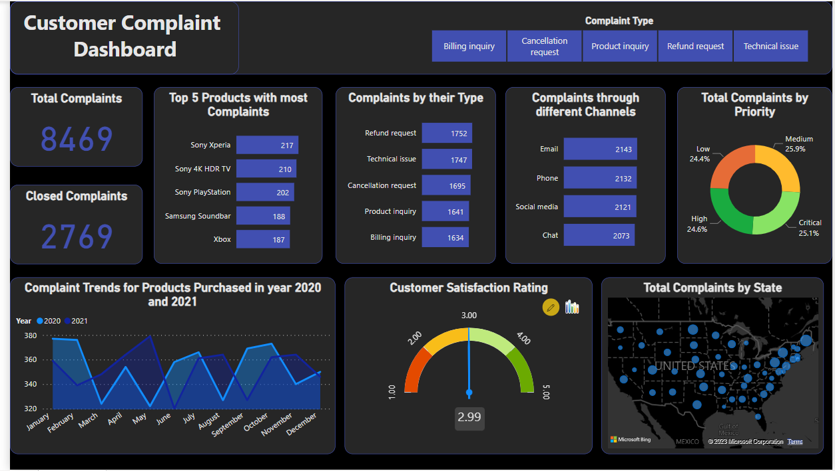
Dashboard

Slide 9
Thank You!

